Slide 1
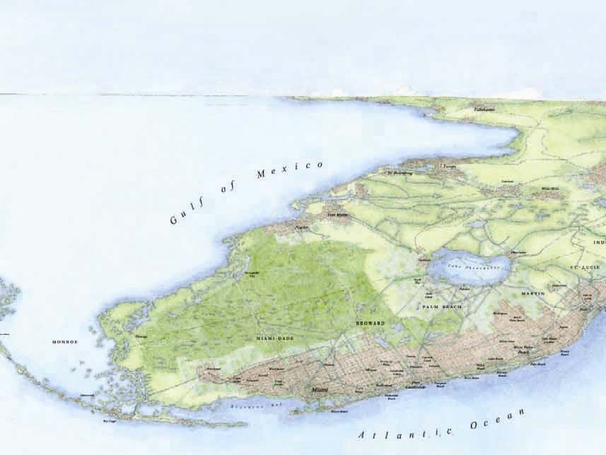

Southeast Florida Regional Vision & Blueprint for Economic Prosperity
Economic Development Briefing
John Kaliski
Cambridge Systematics, Inc.
February 15, 2012

Slide 2

Presentation Outline
Current realities
Global trends
Opportunities and
challenges for
Southeast Florida
How do we get started?
Source: Florida Trend.

Slide 3
Employment Growth Has Resumed
Year-Over-Year Percent Change
8%
6%
4%
2%
0%
2002
2003
2004
2005
2006
2007
2008
2009
2010
2011
-
2%
-
4%
-
6%
-
8%
SOUTHEAST FLORIDA
Florida
United States
Source: U.S. Bureau of Labor Statistics, “Quarterly Census of Employment and Wages.”

Slide 4
Recent Growth Led by Services
Annual Change in Jobs, 2010-2011 (Thousands)
Source: U.S. Bureau of Labor Statistics.

Slide 5
Unemployment Is Easing Downward
Source: U.S. Bureau of Labor Statistics, “Local Area Unemployment Statistics.”

Slide 6
Foreclosures Remain High
Source: Florida Department of Economic Opportunity, compiled from RealtyTrac, Inc.
Total housing units receiving a filing notice, per month.

Slide 7
Wages Remain Below U.S. Average
Index, U.S.=1.0
Source: U.S. Department of Commerce, Bureau of Economic Analysis.

Slide 8
Per Capita Income Has Lost Ground
Index, U.S.=1.0
Source: U.S. Department of Commerce, Bureau of Economic Analysis.

Slide 9
Poverty Is Rising
Share of Population Living in Poverty
Source: U.S. Census Bureau Small Area Income and Poverty Estimates (SAIPE).

Slide 10

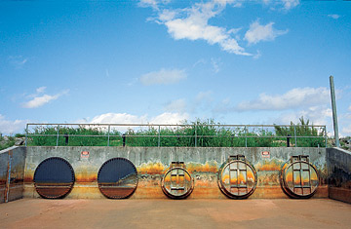

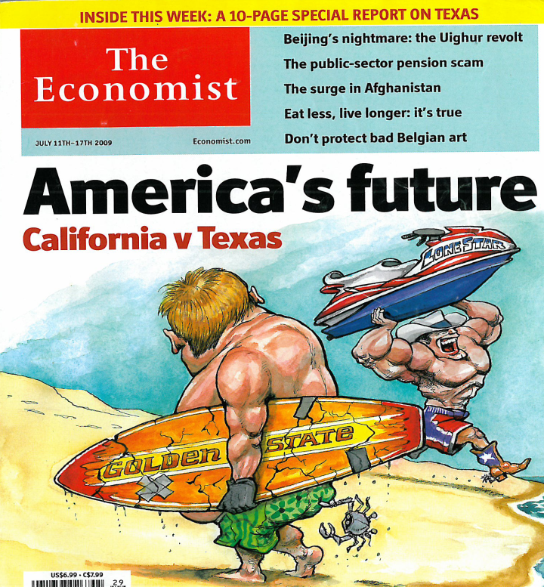
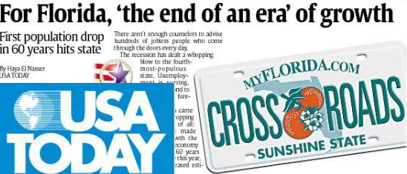
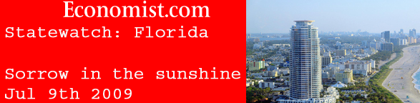
The Florida We’ve Known Is Over
Is Florida the
Sunset State?
9
Notes:
So it is no wonder we hear the question…Is Florida over?
Obvious answer is no, Florida with its many assets and opportunities is far from over. BUT…the Florida that we’ve known IS over.
In the 1970’s, we were the 5th cheapest state. Economic Development mantra was “we’re cheap, got lots of land, beaches and sun. Come on down!” This strategy managed to drive us to point where 1,100 people a day were moving in. Perhaps even some of you.
Today our costs place us at 19th most expensive. Florida is no longer a “low-cost” state. We’ve still got land, beach and sun but we have a different fundamental economic base…with its incumbent consequences.
This very point was emphasized in recent Wall Street Journal, New York Times, the Economist and Time Magazine articles which asked the very pointed question “Is Florida Over?” They formed their arguments around our states’ changing migration pattern and overall costs.
We’ve seen significant changes in wages, housing costs, property taxes, and other costs of living and costs of doing business. So we need to re-examine how we compete as a higher cost state.
The easy approach would be to find a “fix” for today that reignites the old “cheap growth” fire, but what we really need is positioning with a long-term, global perspective.

Slide 11
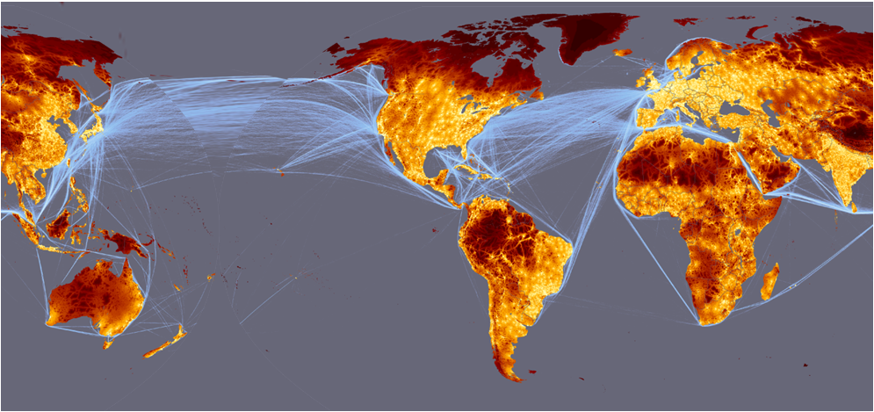
A New Economy: Global Markets
Source: European Communities, 2008
Notes:
Second, trade routes are changing and these changes favor Florida.
Graphic highlights major trade routes – over the past few decades, two major sea trade routes serving the U.S. :
Between Europe and Eastern US across the Atlantic Ocean
Between East Asia (Japan, S. Korea, and increasingly, China) and Western US across the Pacific Ocean
Major changes anticipated over the next few decades
Panama Canal widening in 2014 – greater use of Panama Canal to bring Asian trade to Eastern US – estimates suggest 25% or more of Asian trade may be diverted from Western US ports to Eastern US through Canal
As Asian production centers shift to South Asia (India, etc) – Suez Canal more direct route to Eastern US
North/south trade between Latin America and Caribbean and Eastern US will grow as Brazil and other nations experience strong economic growth (wild card: reopening of Cuba)
Africa may become more significant as well - -Florida is closest US state to Africa
All of these trends taken together place Florida in a very strategic position at intersection of multiple trade lanes

Slide 12
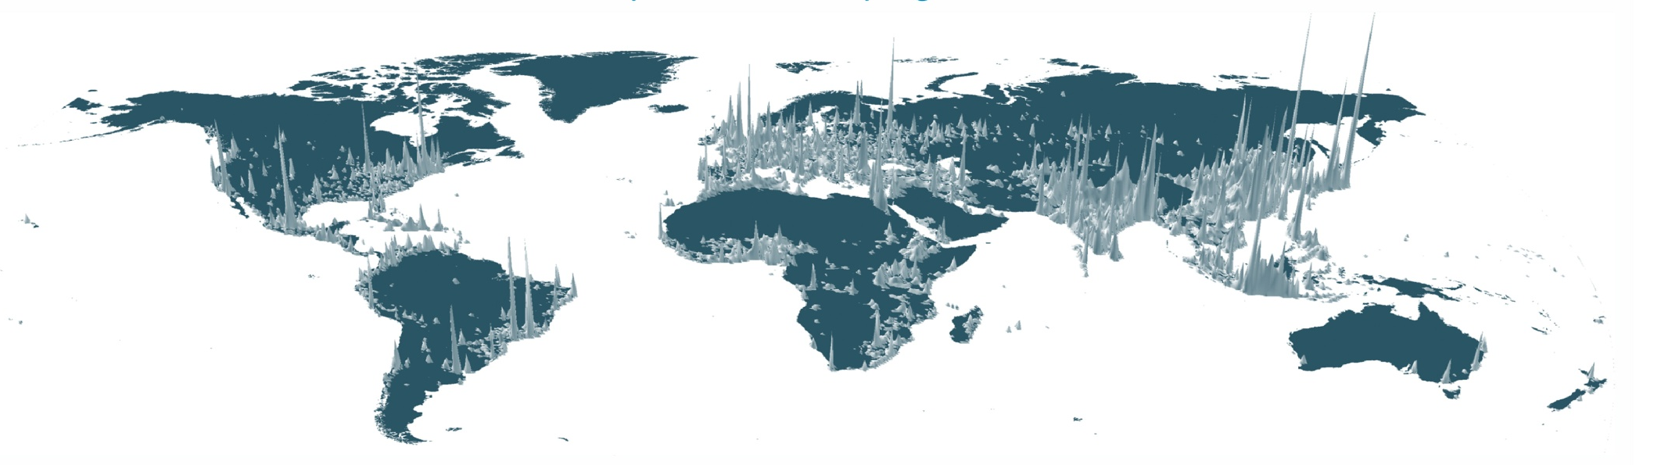

A New Economy: Global Competition
Global Population Centers
Global Economic Centers
Source: WhosYourCity.com.

Slide 13
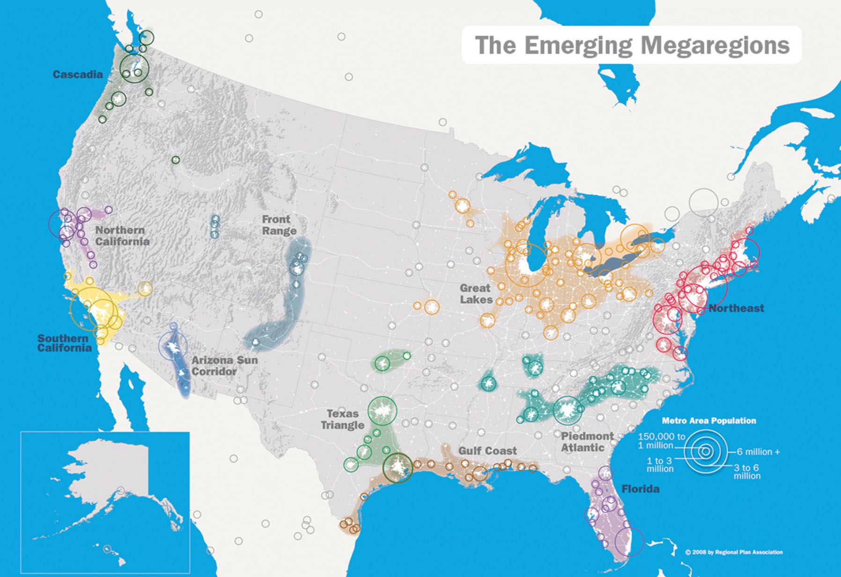
A New Economy: Regions, Megaregions
Source: America 2050.
12
12

Slide 14
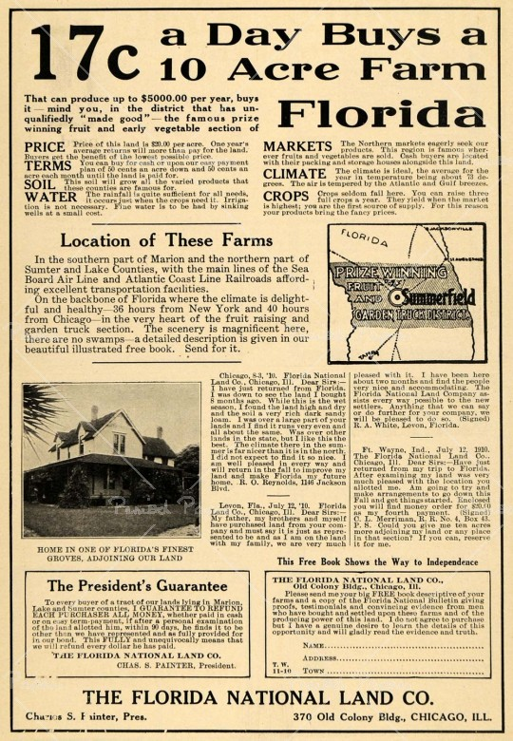

How Do We Compete?
Florida then…
Florida now…
Low-cost labor
Production
Location
and land
Low cost of living
Natural
resources
Individual
communities
World-class talent
Innovation
Global connections
Quality places
Sustainable
environment
Integrated
regions
13
13

Slide 15
Changing Industry Mix
Innovation
& Technology
Tourism
Construction
Business &
Personal
Travel
Community
Development
Agriculture
Global Trade
&
Logistics
Agriculture
Financial and
Professional
Services
Past
Future?
14

Slide 16
Opportunity: Global Trade
Value of Exports and Imports (In Billions)
Source: WISERTrade based on U.S. Census Bureau foreign trade data; Value of trade through the Miami Customs District.

Slide 17
Opportunity: Tourism & Travel
Annual Overseas Visitors to Miami (In Millions)
Source: U.S. Department of Commerce, International Trade Administration.

Slide 18
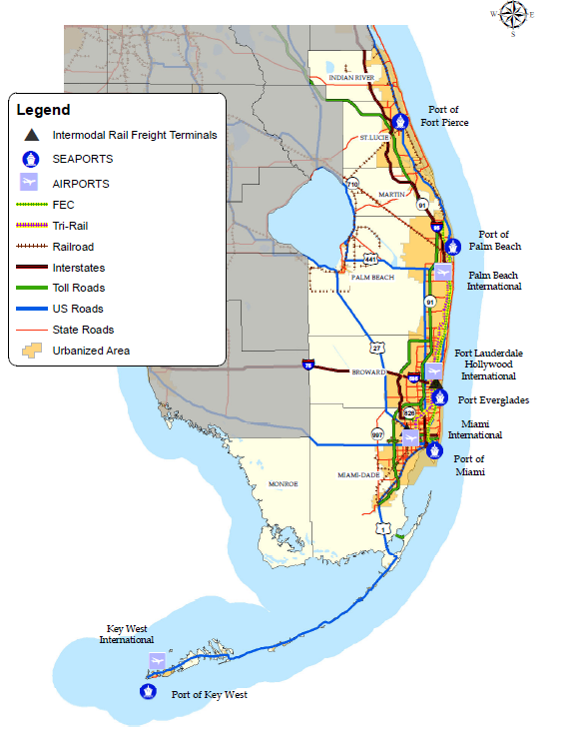
Global Connectivity Is Critical

Slide 19
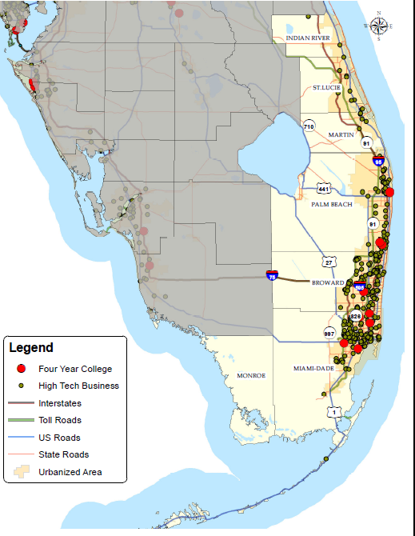
Opportunity: Innovation

Slide 20

Challenge: Talent Supply
10…
6…
3…
2…
…students in a 9th grade class
…graduate from high school
…continue to college within two years
…earn college credit within two years
2002
2005
2007
2009
Source: Florida Board of Education 2011.
Notes:
Assistance defined as food stamps or cash payments
1 in 5 homes in default or foreclosure. The Mortgage Bankers Association says 22% of all Florida homes are in default on their mortgages or in the foreclosure process. Florida has the 7th highest rate in the nation with 1 in every 343 housing units getting a foreclosure filing, 25,641 Florida properties received foreclosure filings in December 2010. Florida foreclosures are up by 208 percent since the low point in December 2006. Cape Coral metro area is the second highest rate in the nation, after Las Vegas, Miami and Orlando are also in the top 10.

Slide 21
Challenge: Workforce Skills
Educational Attainment 2006-2010
55%
59%
Population over 25...
28%
…with less than a
High School degree
…with HS, Associate’s degree,
or some college
…with a Bachelor’s degree,
or higher
17%
57%
26%
15%
Southeast Florida Region
28%
15%
Florida
United States
Source: U.S. Census Bureau, American Community Survey 2006-2010 five-year estimates.

Slide 22
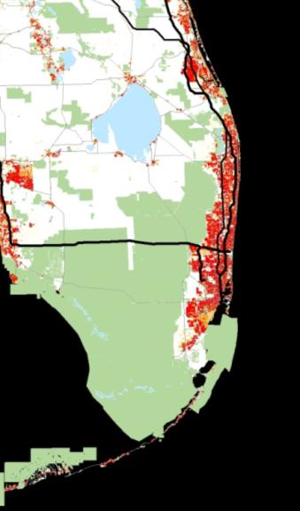
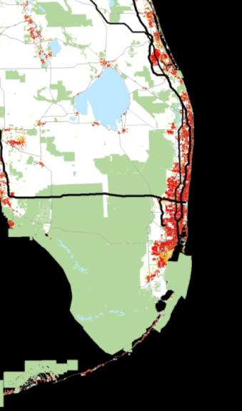
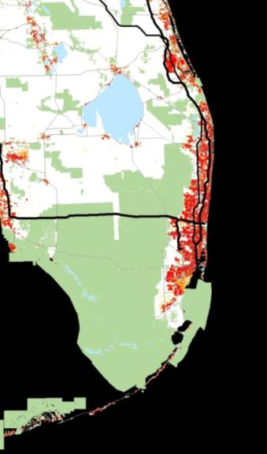

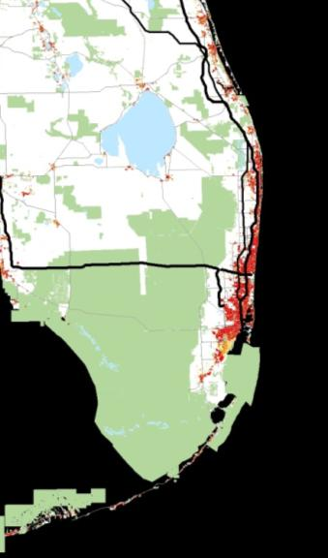
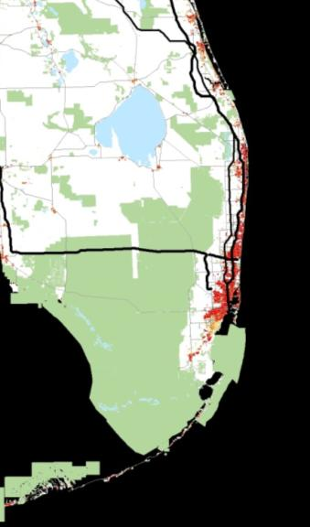
Opportunity: Community of Choice
2009
1990
2000
1980
1970
1960

Slide 23
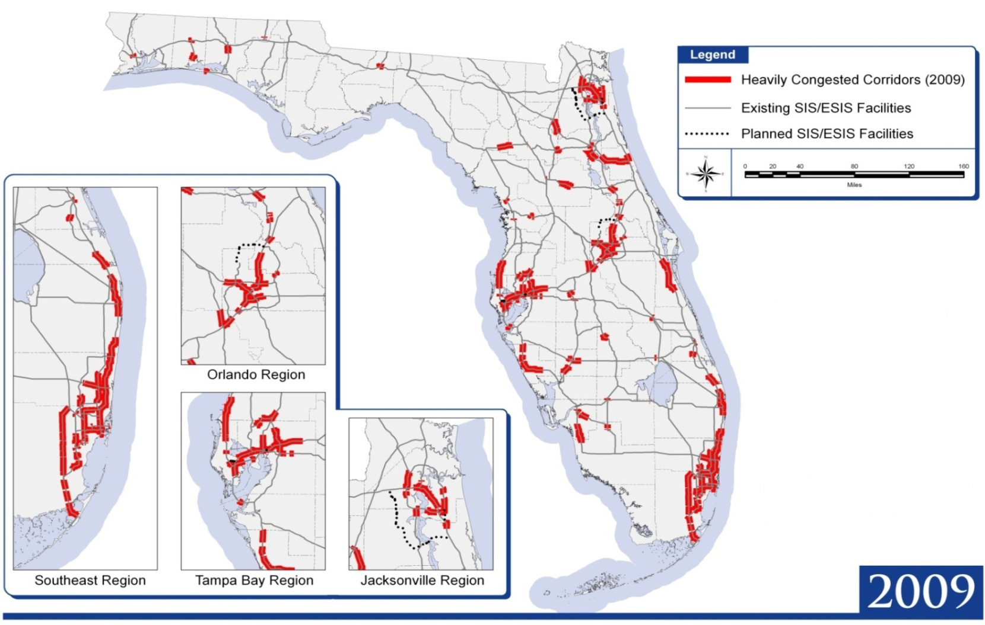
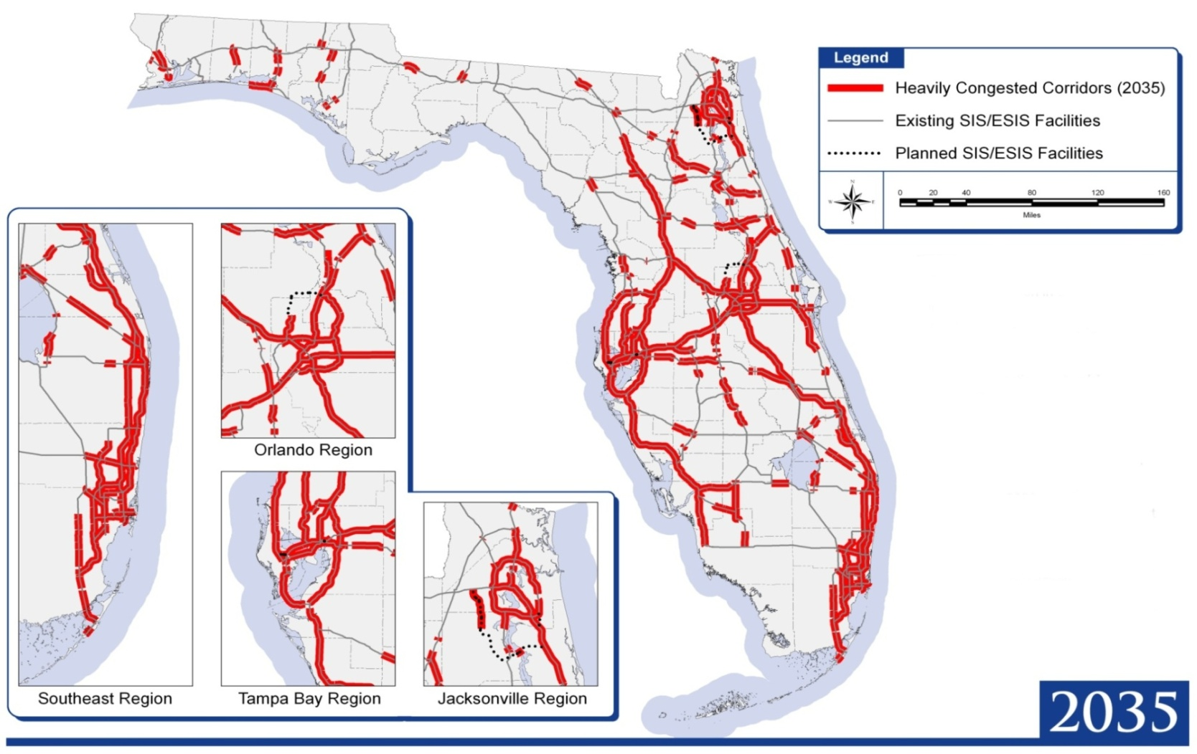
Challenge: Mobility
Source: Florida Department of Transportation.
Notes:
The growth in travel by residents, visitors, and freight will increase pressure on Florida’s transportation system, especially on the highway corridors. This map shows the SIS highways that were congested in peak periods in 2009; that is, they did not meet level of service standards.
Highways that fall below the standards include portions of the Interstate I-4, I-75, and I-95 corridors and other key corridors in Florida’s urban areas– but also a few corridors in emerging regions and rural areas.
NOTES:
Heavy congestion in Urban Areas means that traffic is either moving bumper to bumper or is stop and go during peak periods (Level of Service E or worse).
Heavy congestion in Rural Areas means that passenger and truck traffic is so heavy during peak periods that changing lanes is very difficult (Level of Service D or worse).

Slide 24
How Do We Get Started?
Align state, regional, and local plans around a common framework
Create 5 year action plan pointing toward a 50-year vision
Integrate with other regions to build Florida’s megaregion
Measure and report progress

Slide 25
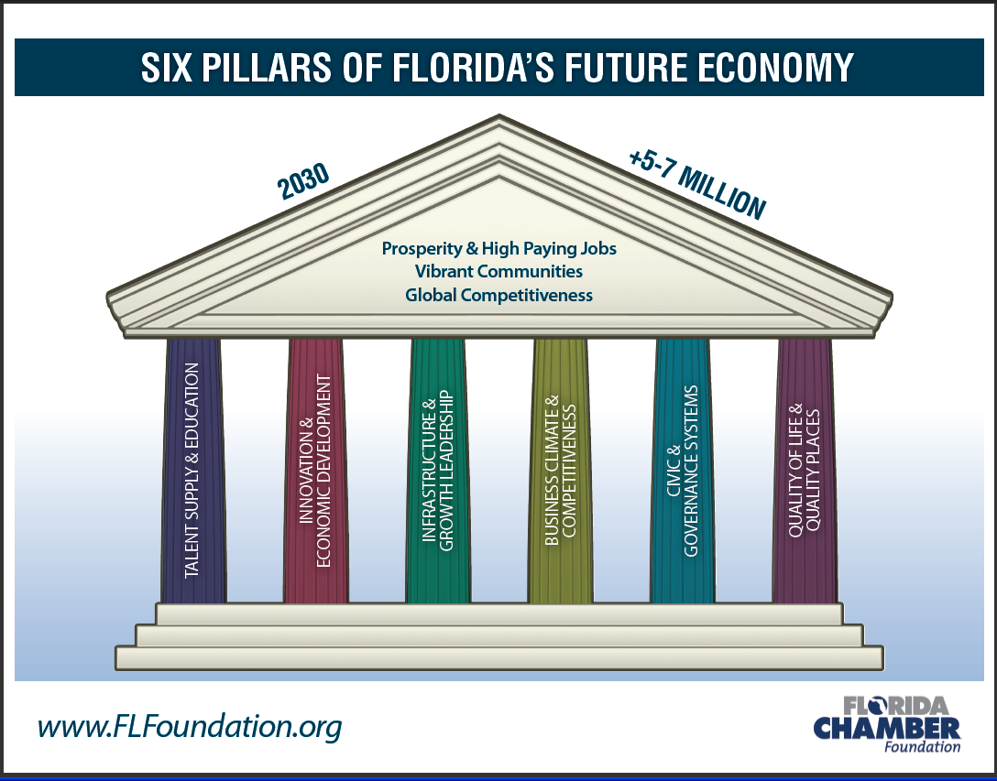
Notes:
24
We have identified 6 drivers to Florida’s Future
Talent. We need to meet the future talent and workforce needs of a state with 7 million more people , Must design an effective pre-K to 20 education system, add STEM (Science, Technology, Engineering and Math) training and build skills for jobs that haven’t even been dreamed of yet. To remain competitive, we must produce 1.5 million more university degrees than on current pace to produce. And prepare those in current workforce for the new next economy.
Innovation. We must have a knowledge-based economy at the cutting edge of technological development. Also, in acknowledgement of different business and competitive landscapes, we need to update our idea of economic development, adding the systems and incentives that will help expand, establish and recruit the jobs of tomorrow.
Infrastructure. Florida’s infrastructure – transportation, communications, energy, water and related systems – historically has been a driver of the State’s growth. These systems are under increased pressure to accommodate current needs, let alone support future growth.
Business Climate. Florida’s business climate is one of the strongest in the nation but remaining competitive is a continued challenge as the State’s economy grows and changes. We have to compare costs and measure our rank in the U.S. and across the globe if we are to compete on the world’s stage.
Civic & Government Systems. Think of all the layers of government, locally and at the state level that impact our lives and livelihoods…all disconnected from the others. We need a governance model that “enables” not “disables” progress. We need limited government intrusion in the free market, predictable laws and regulations, reforms to protect Florida from unfair and harmful amendment proposals. And we need an engaged citizenry that works to make a difference at the community level rather than deferring all action to government.
Quality of Life & Place. Prosperous and livable communities brought many of us here and keep us here. All Florida must be safe, diverse, healthy and energized; with an identity, a sense of place; the best place to live, work and play.

Slide 26

25

Slide 27

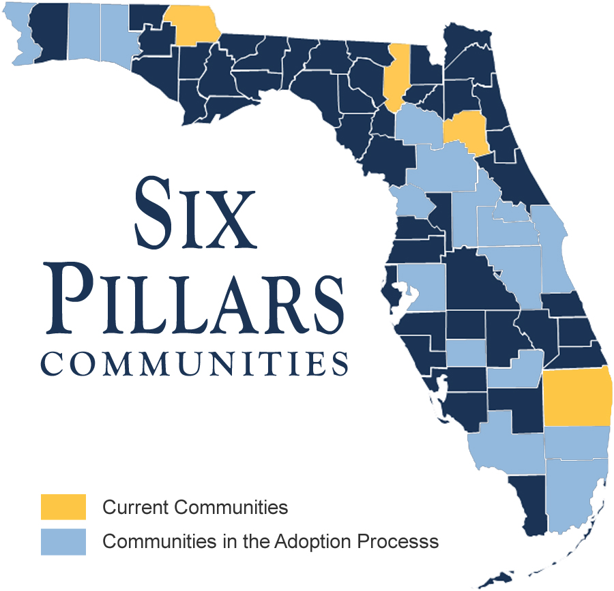
Six Pillars Communities
Notes:
Caucus System is the product of many years of research by the Foundation to identify the critical factors determining Florida’s future.
A Caucus per Pillar was created to construct a strategic plan for the year 2030 focusing on high-wage jobs, global competitiveness and vibrant communities and to also establish a continuous source for insight and feedback

Slide 28
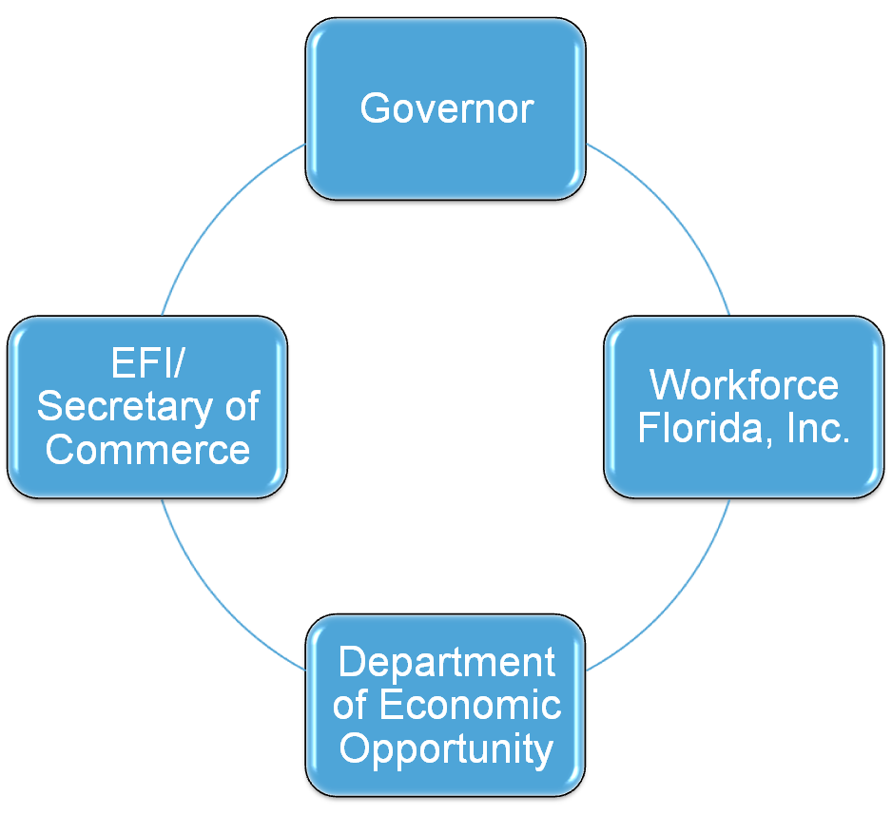
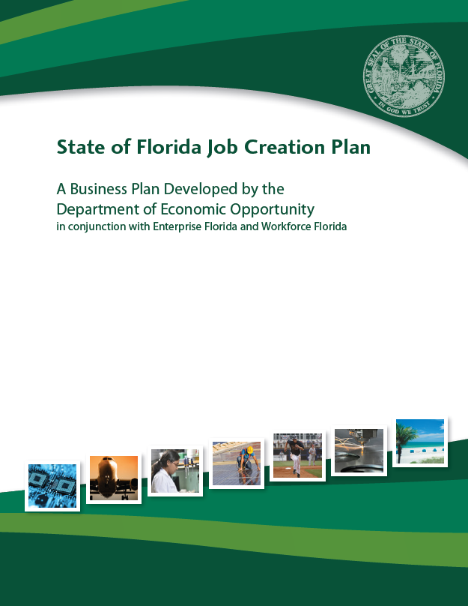
Florida’s New Statewide Economic Development Structure

Slide 29


Alignment of State, Regional, Local Plans
Statewide Strategic Plan for Economic Development
  Coordinated with 2030 Six Pillars Plan and 2060 Statewide Vision
Regional Comprehensive Economic Development Strategy
  Joint effort of
  South Florida and
  Treasure Coast RPCs
  Input into Regional Vision
  and Blueprint for Economic Prosperity

